Slide 1
CS 170 segment 10 knowledge of AI
Notes Based from Eamonn Kough

Slide 2
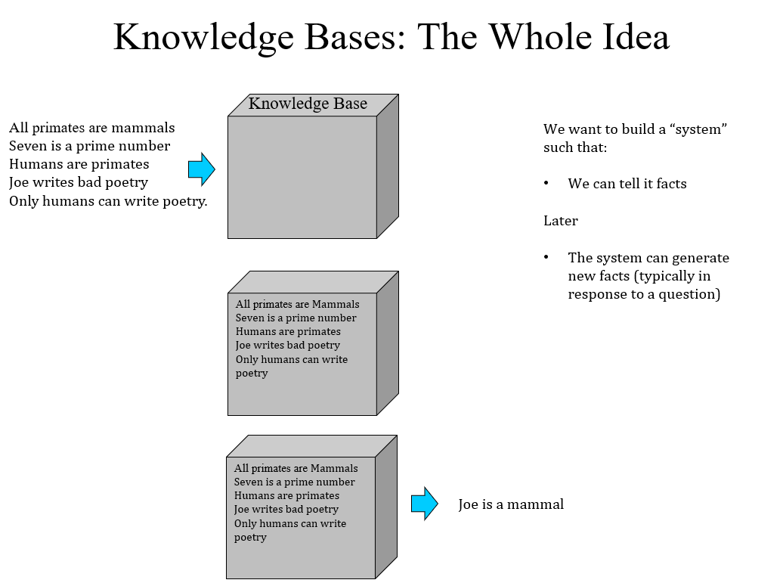

Slide 3
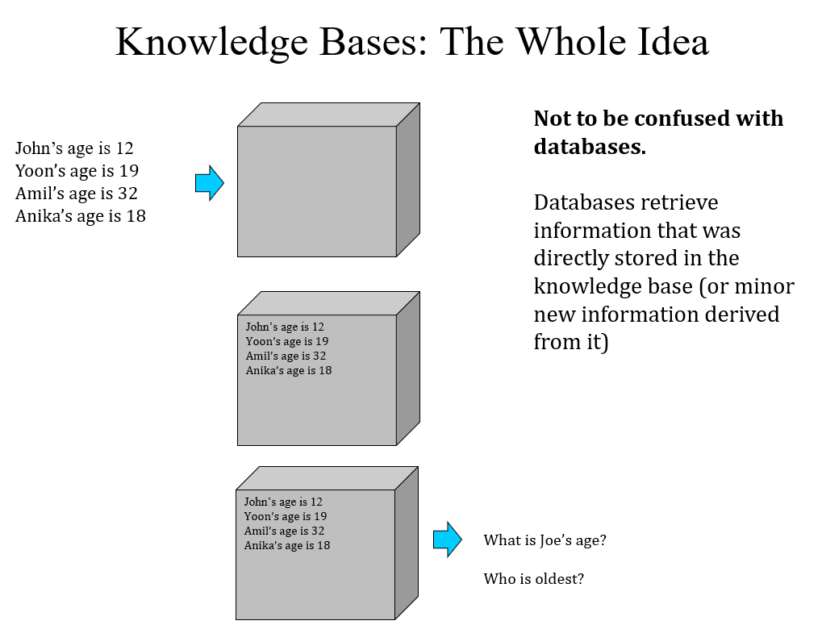

Slide 4
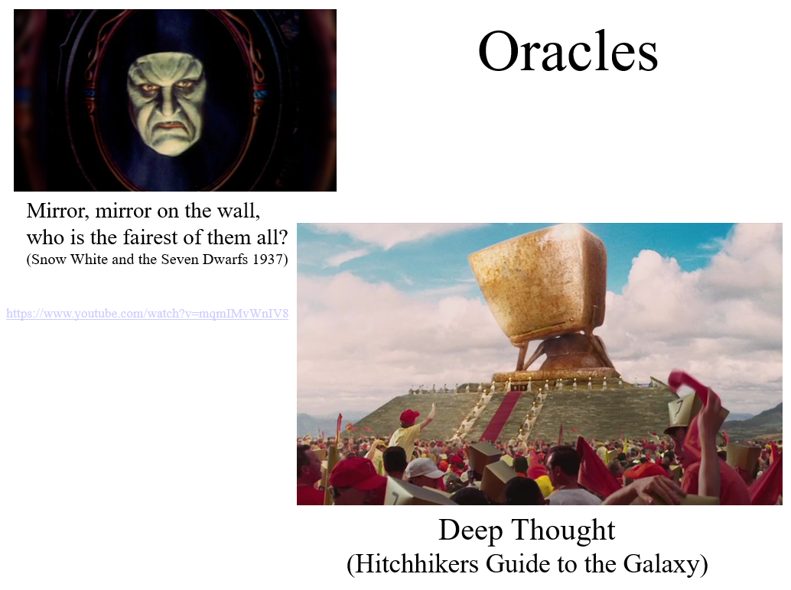

Slide 5
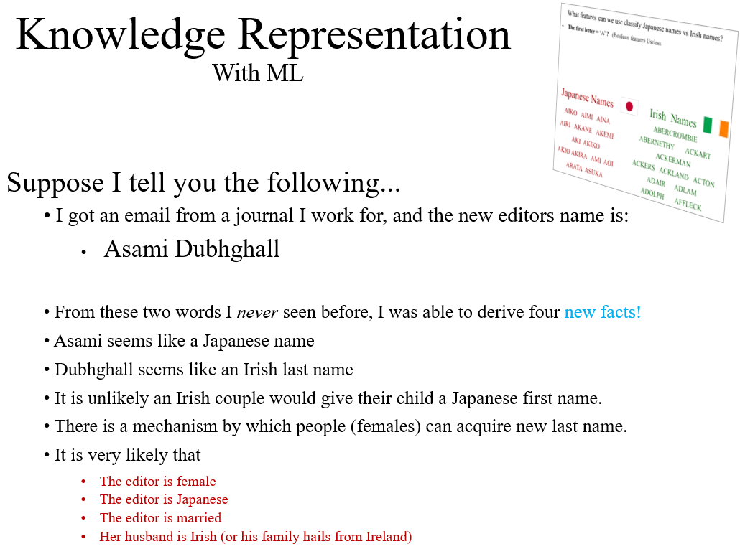

Slide 6
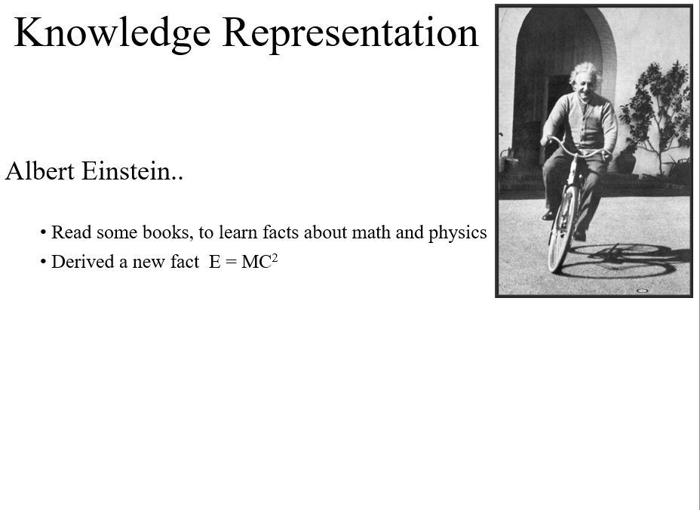

Slide 7
Knowledge Representation
A subarea of Artificial Intelligence concerned with understanding, designing, and implementing ways of representing information (knowledge) in computers so that programs (agents) or humans can use this information…
• to derive new information that is implied by it,
Optionally
• to converse with people in natural languages,
• to decide what to do next
• to plan future activities,
• to solve problems in areas that normally require human expertise.

Slide 8
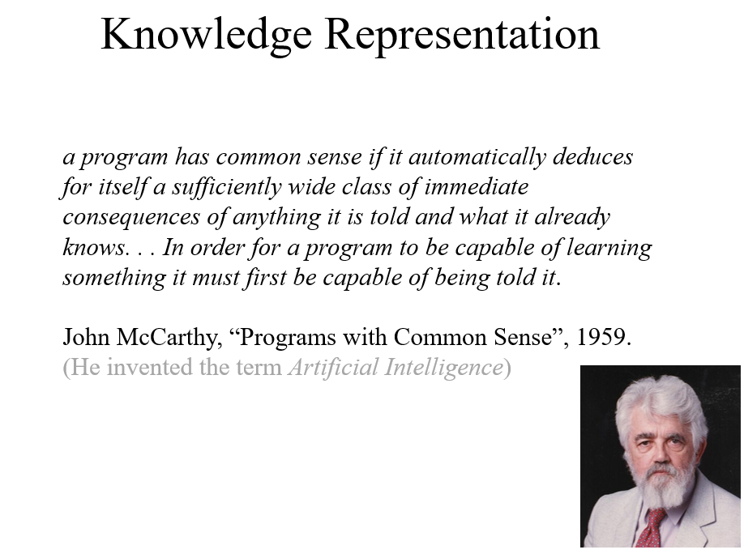

Slide 9
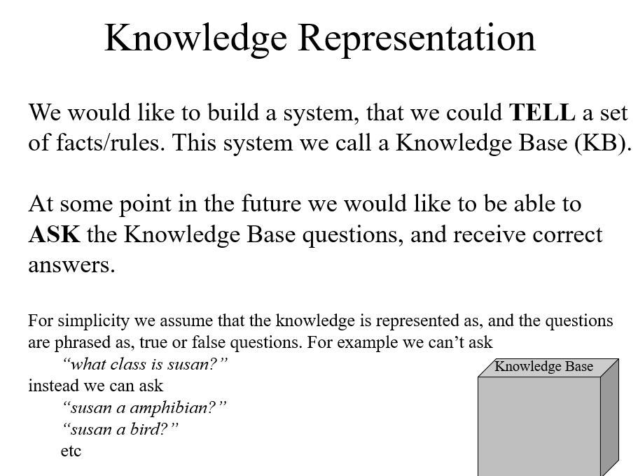

Slide 10
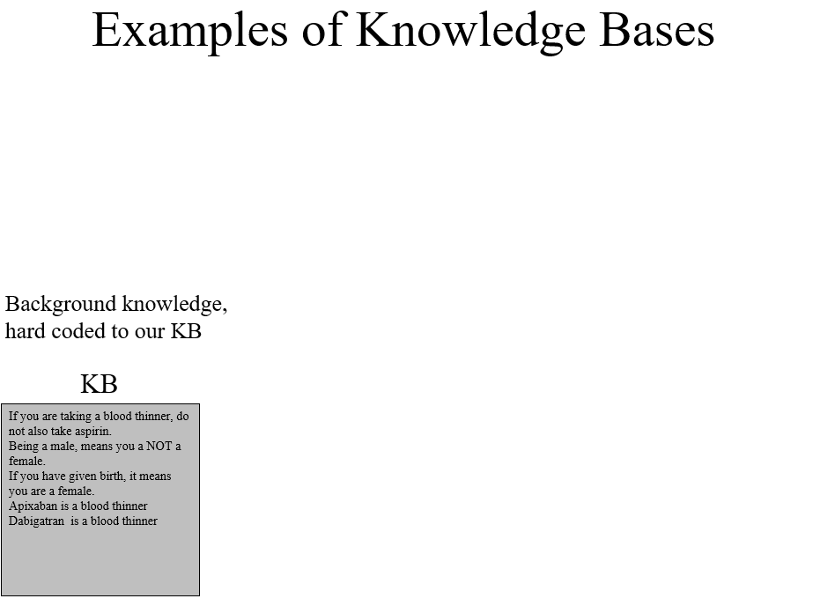

Slide 11
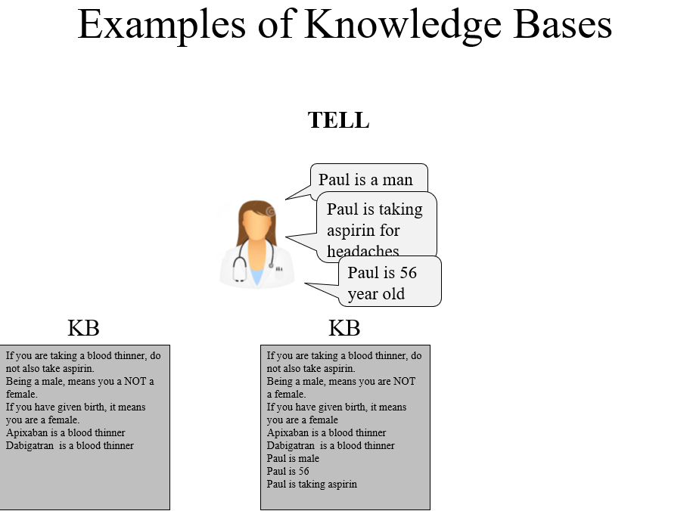

Slide 12
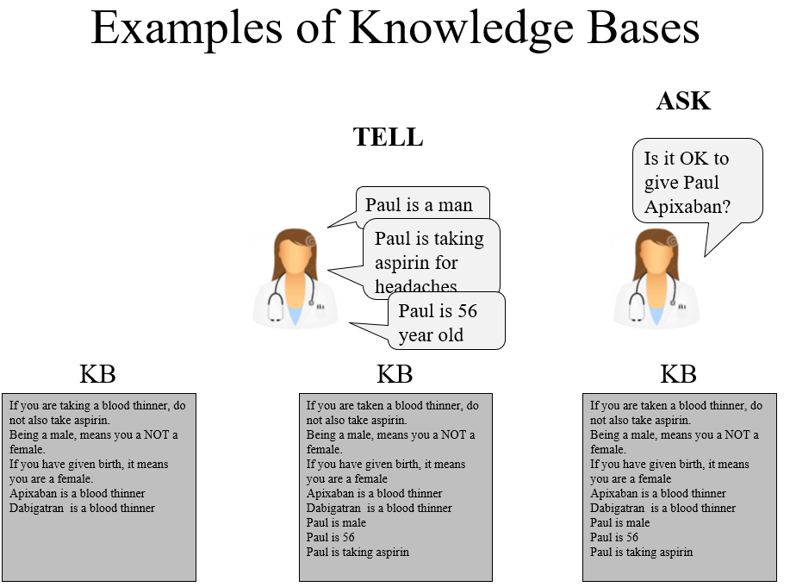

Slide 13
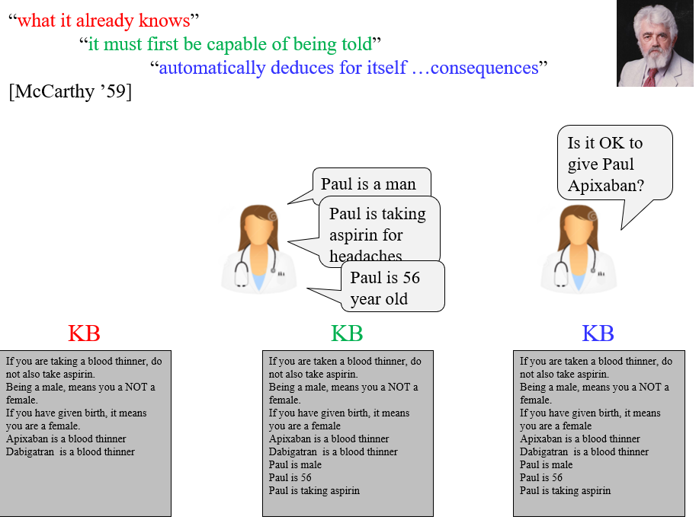

Slide 14
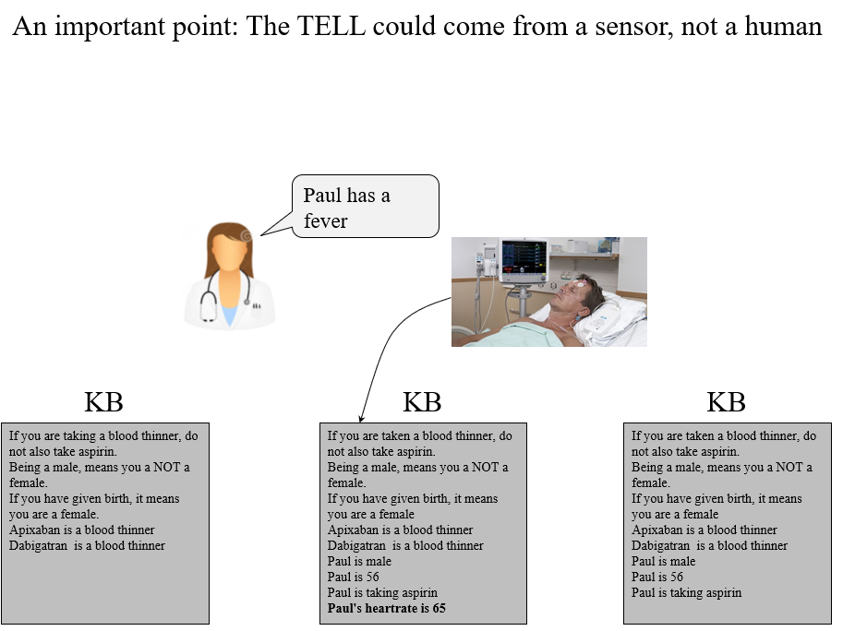

Slide 15
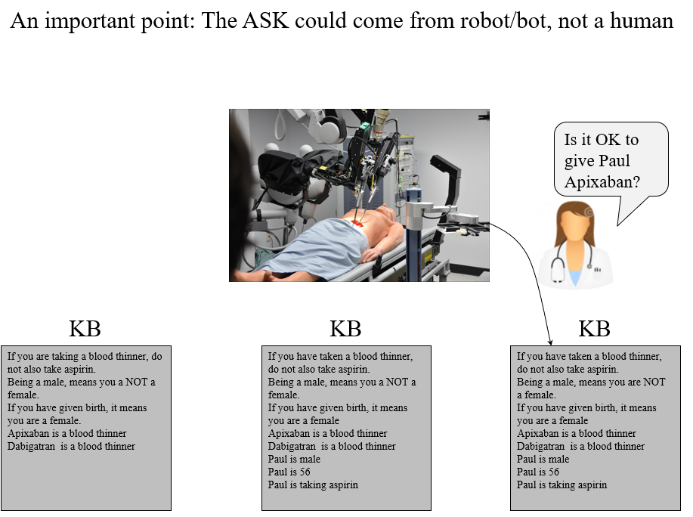

Slide 16
Another Example of Knowledge Base
NELL: Never-Ending Language Learning at CMU
Every day for the last 10 years, NELL reads the web, and TELLS its knowledge base new “facts” it has learned
http://rtw.ml.cmu.edu/rtw/

Slide 17
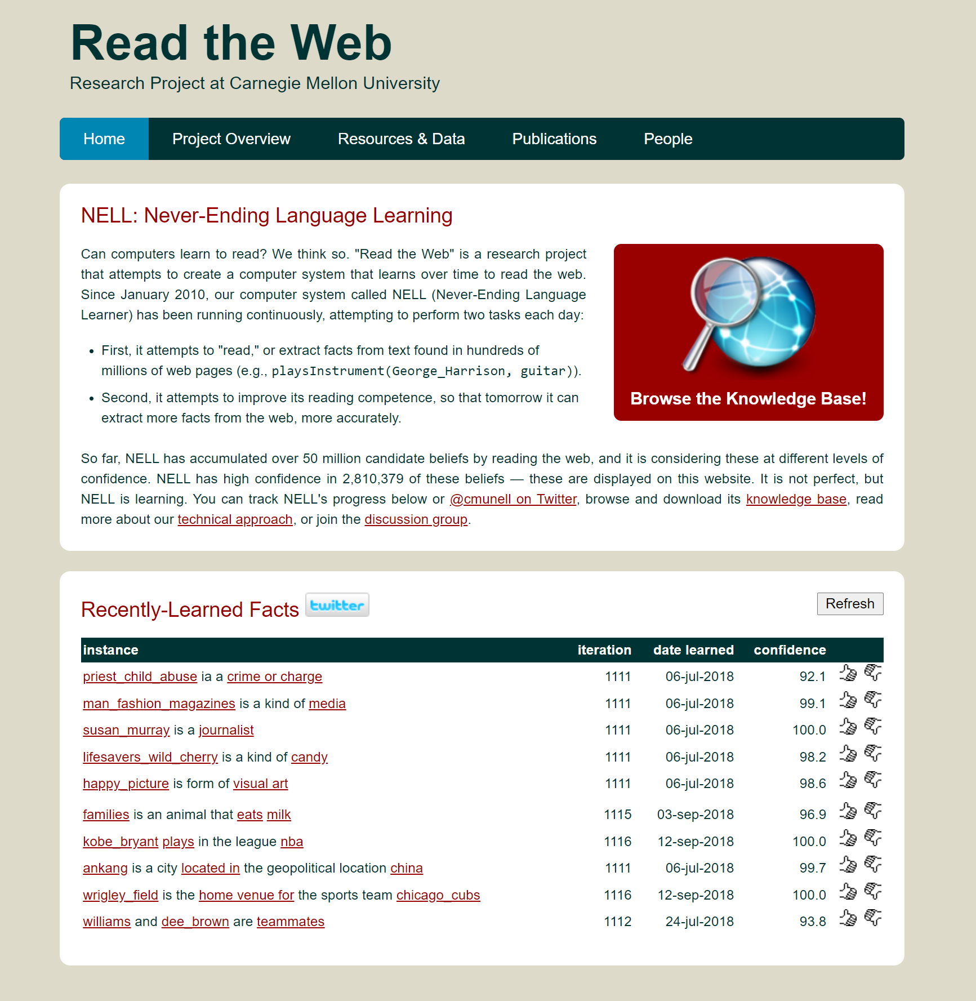

Slide 18
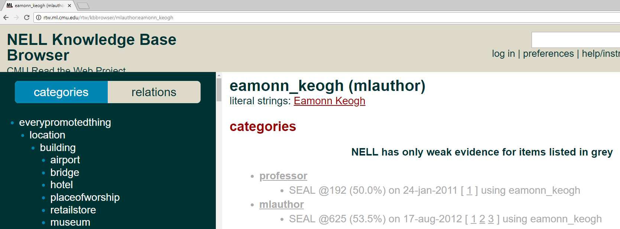

Slide 19
Knowledge Representation
More concretely, if we collect all our facts into a knowledge base KB, and we later want to know if a fact P is true. We will try to show that given the facts in our database, P must be true. We write this as
KB |- P Read as KB entails P
If you are taken a blood thinner, do not also take aspirin.
Being a male, means you a NOT a female.
If you have given birth, it means you are a female
Apixaban is a blood thinner
Dabigatran is a blood thinner
Paul is male
Paul is 56
Paul is taking aspirin
|-
OK to give Paul Apixaban

Slide 20
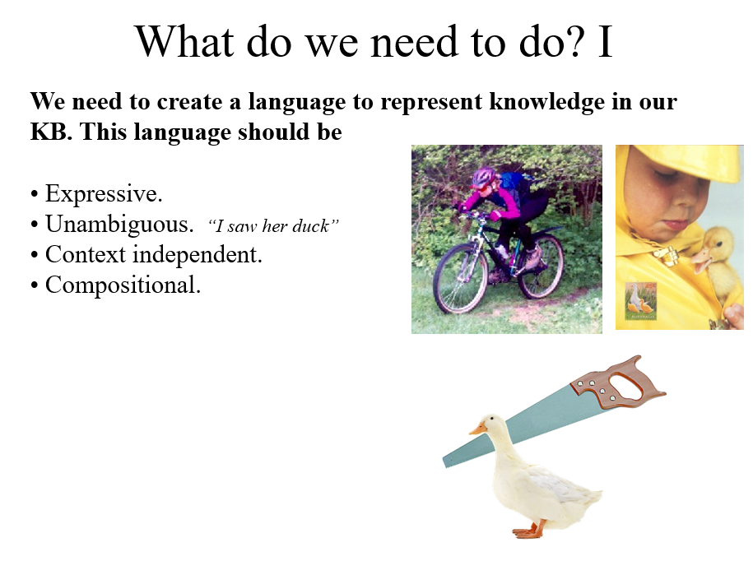

Slide 21
What do we need to do? II
We need an algorithm to answer the questions we might ASK.
The algorithm should be
Sound (only true facts are derived)
Complete (all true facts can be derived)
Efficient (we call ask a question and get an answer in reasonable time/space)

Slide 22
What language should we use?
Natural language, ie English, ASL, Cantonese. Too ambiguous.
Programming Language, i.e. C++, Lisp, Java. Not very expressive or intuitive.

Slide 23
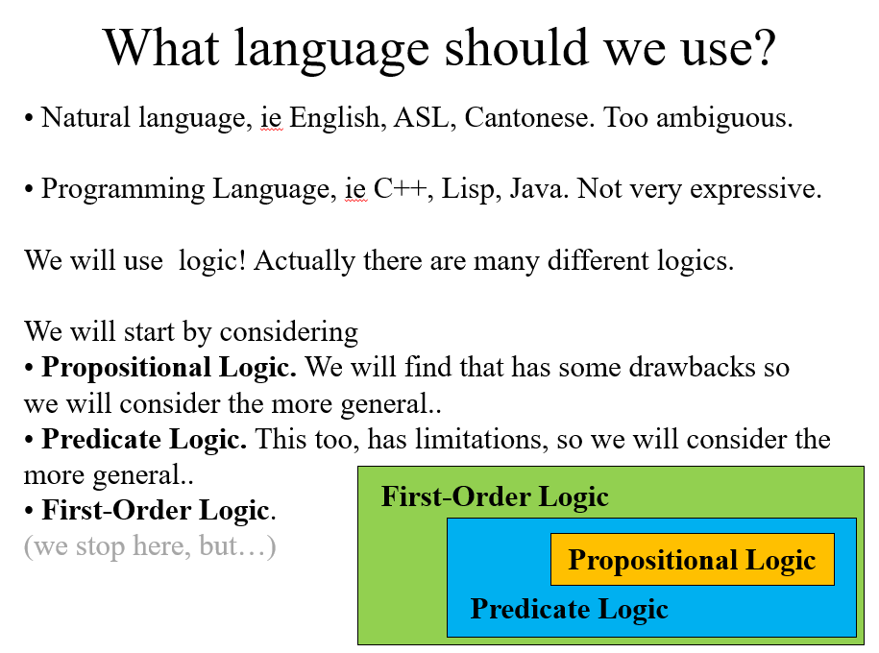

Slide 24
A logic language consists of semantics and syntax
Semantics: What the sentences mean.
Syntax: How legal sentences can be assembled.

Slide 25
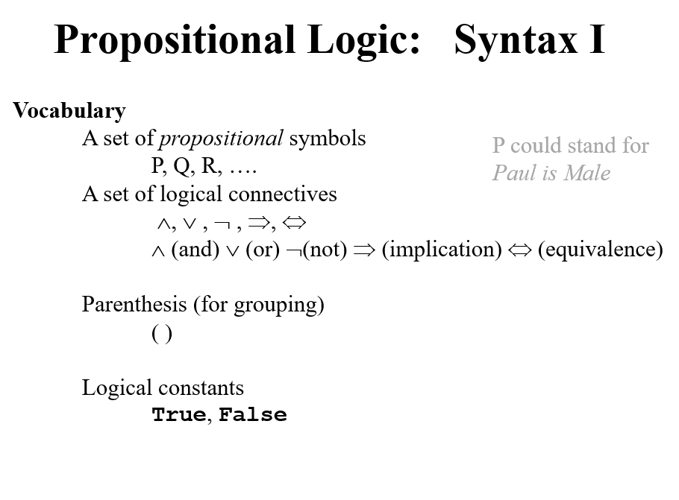

Slide 26
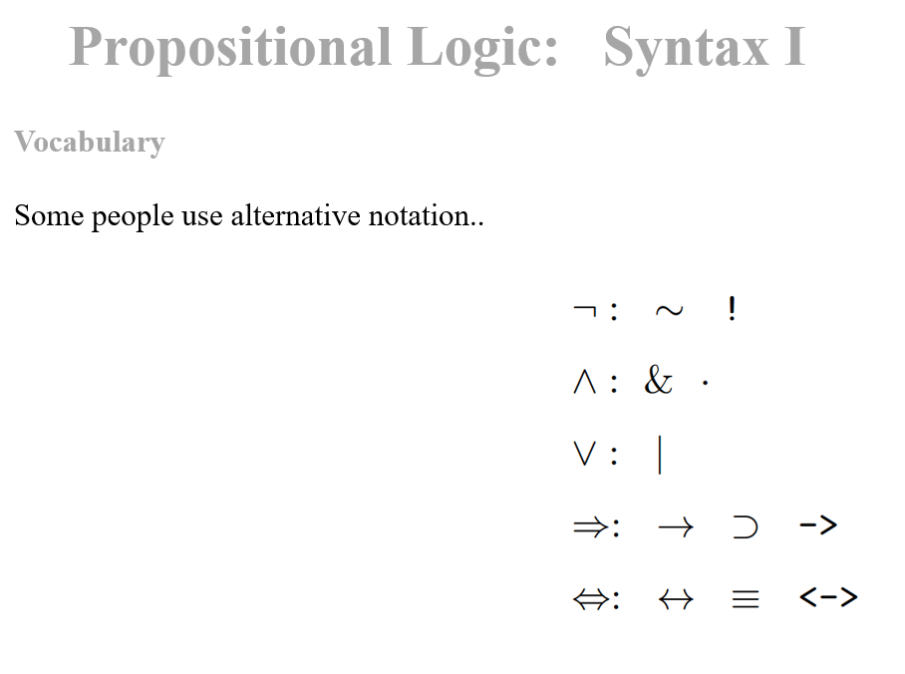

Slide 27
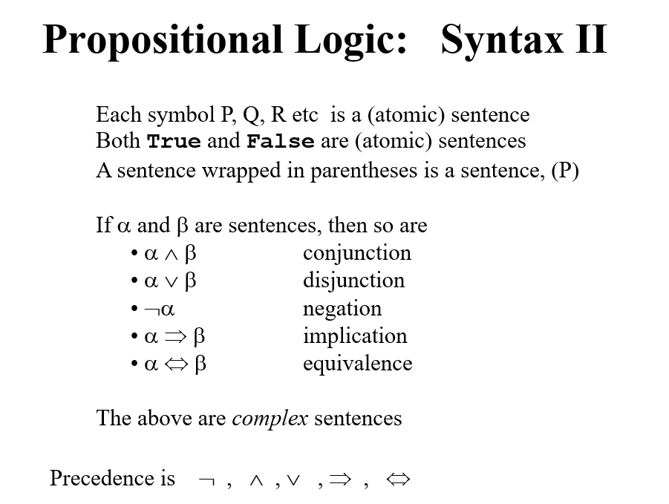

Slide 28
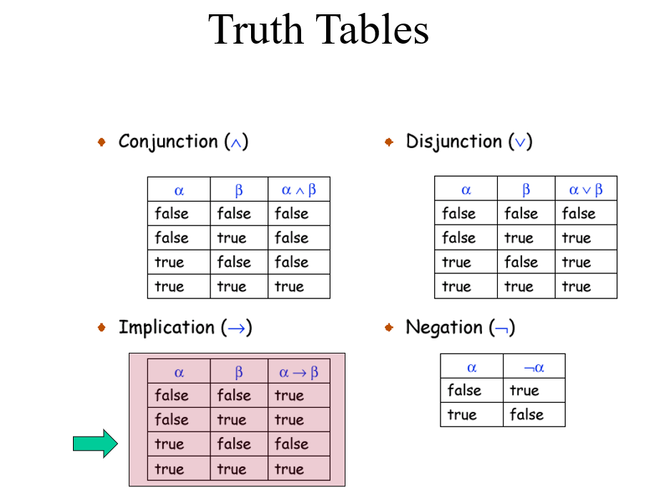

Slide 29
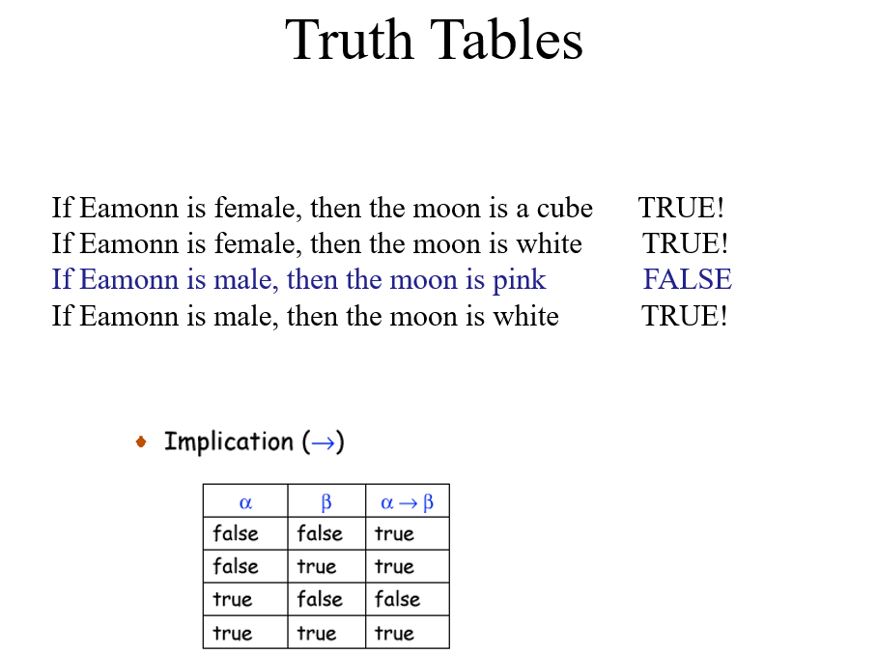

Slide 30
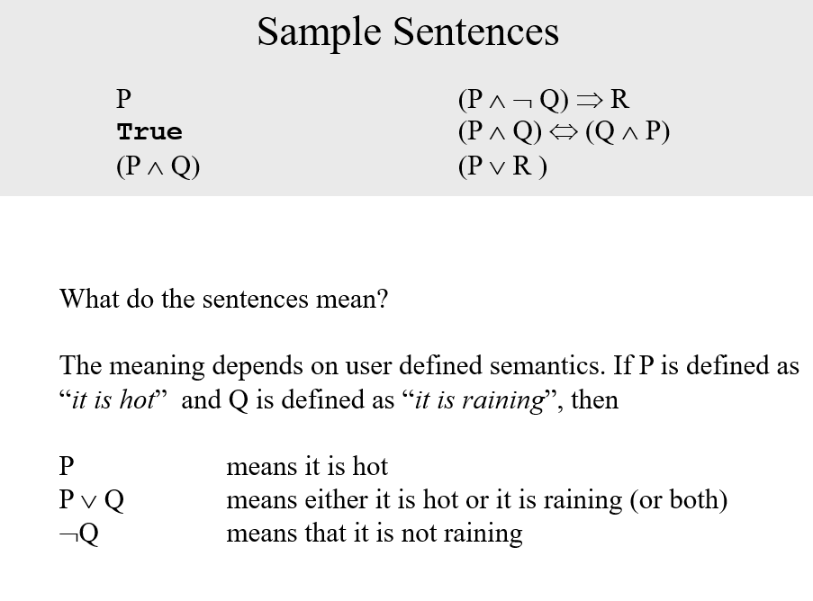

Slide 31
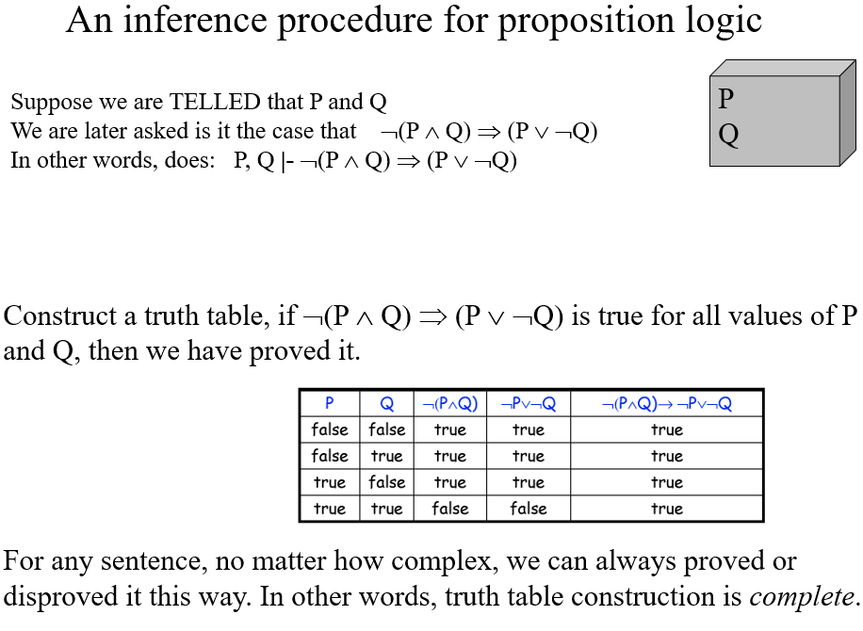

Slide 32
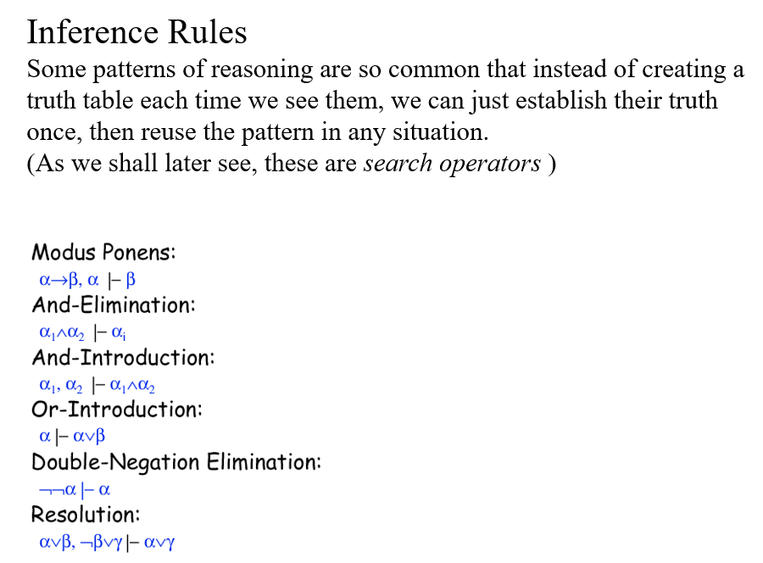

Slide 33
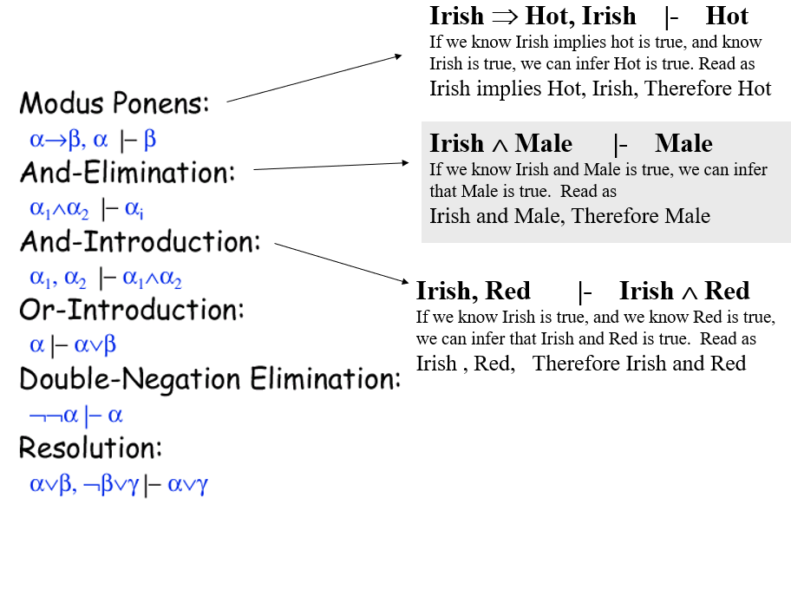

Slide 34
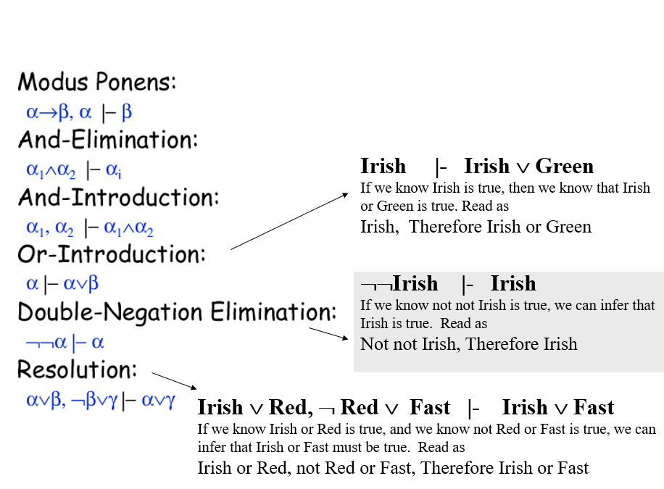

Slide 35
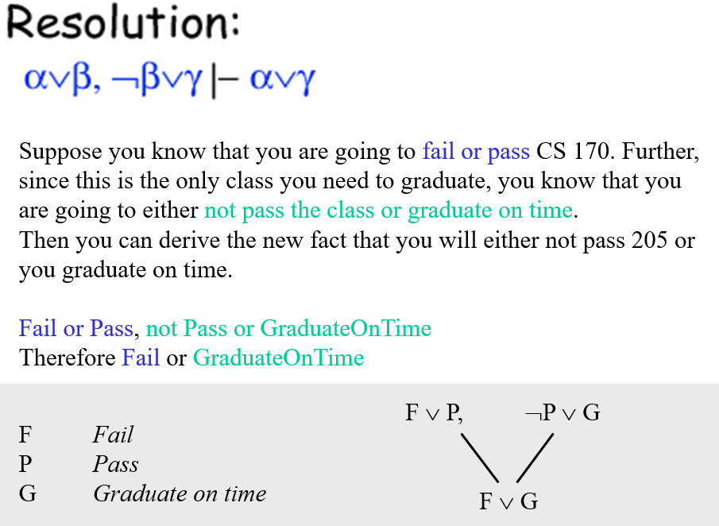

Slide 36
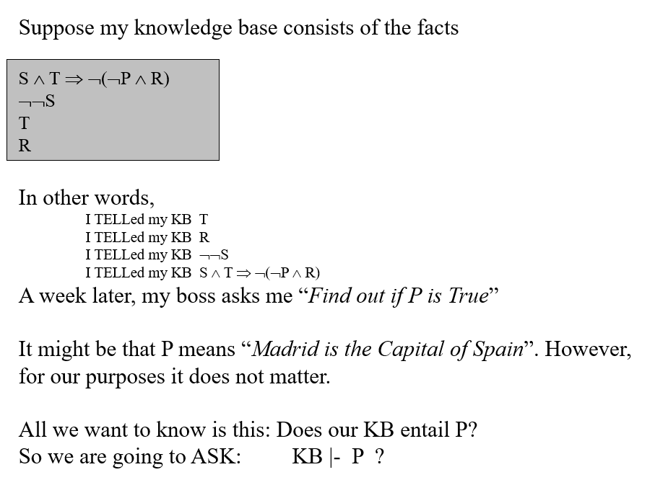

Slide 37
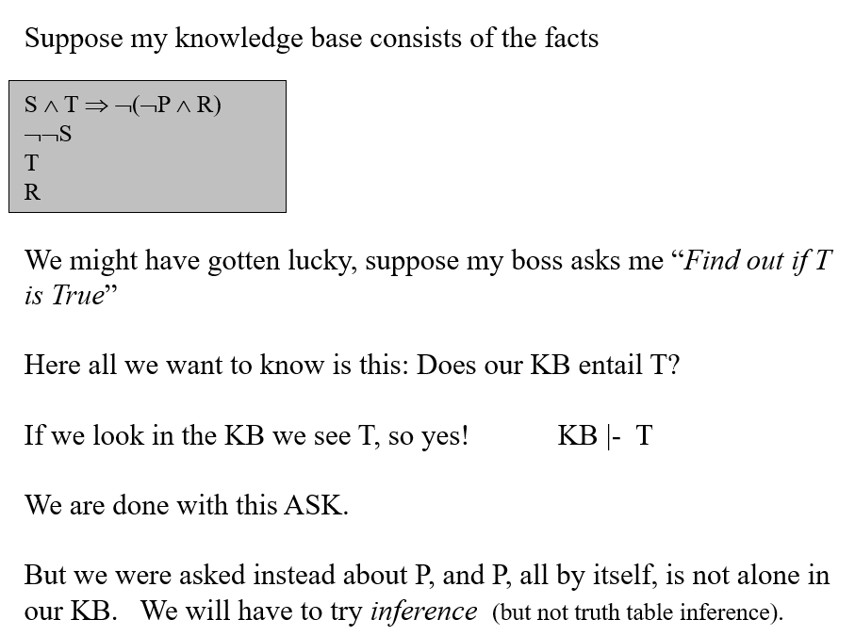

Slide 38
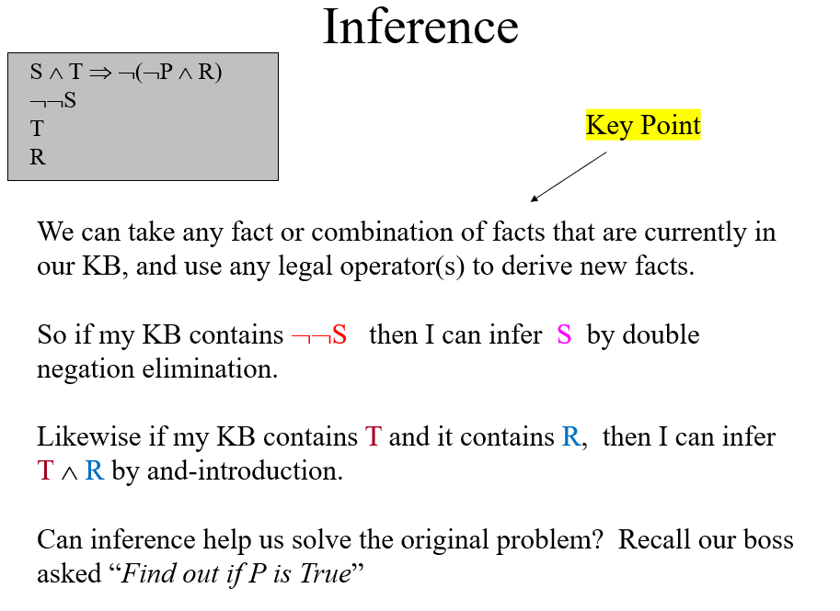

Slide 39
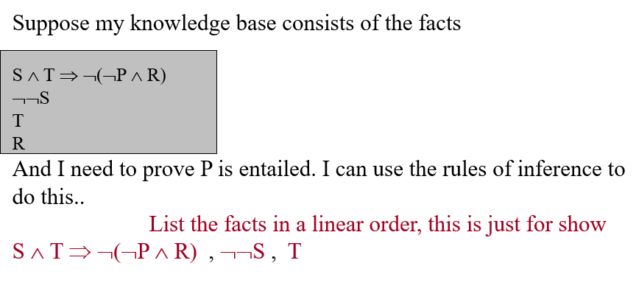

Slide 40
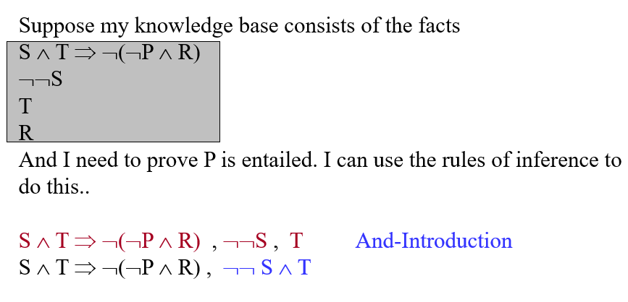

Slide 41
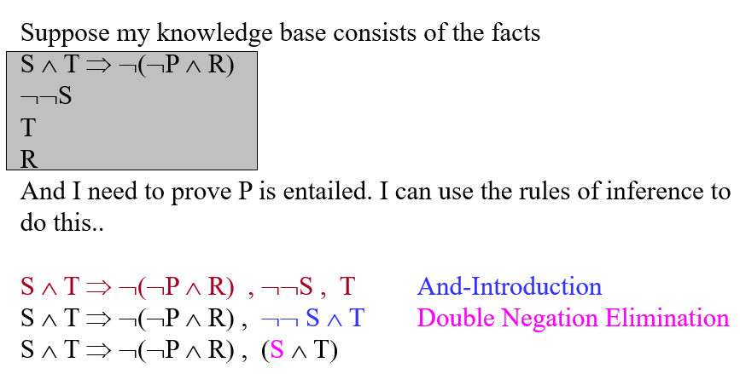

Slide 42
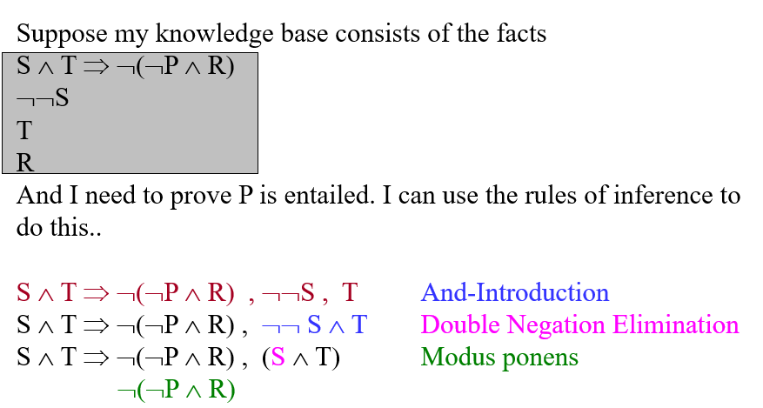

Slide 43
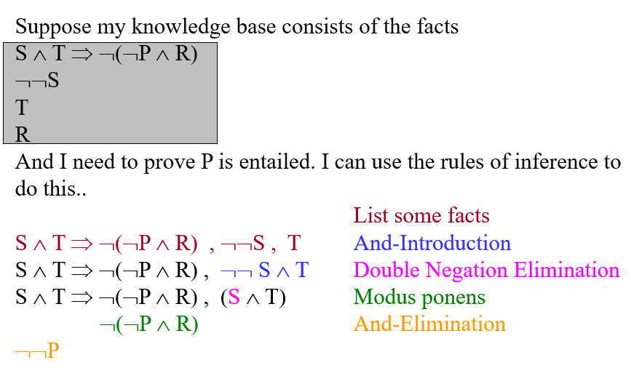

Slide 44
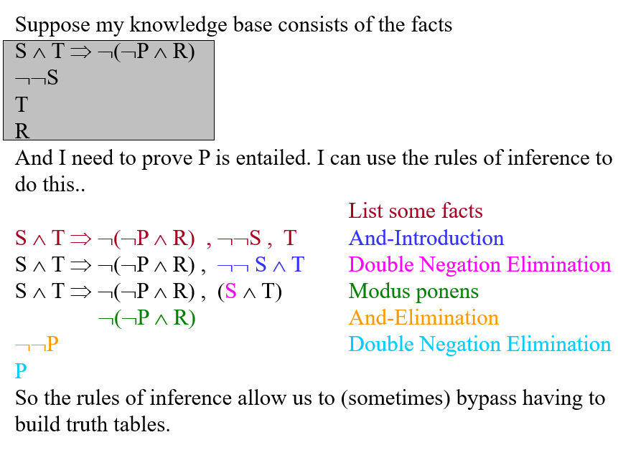

Slide 45
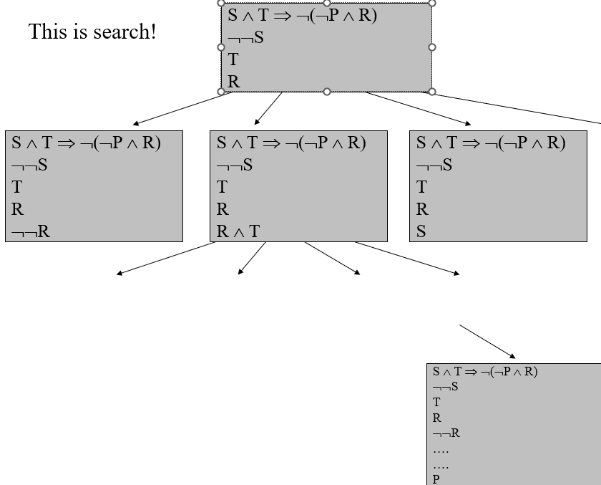
S ∧ T ⇒ ¬(¬P ∧ R)
¬¬S
T
R
¬¬S ∧ R

Slide 46
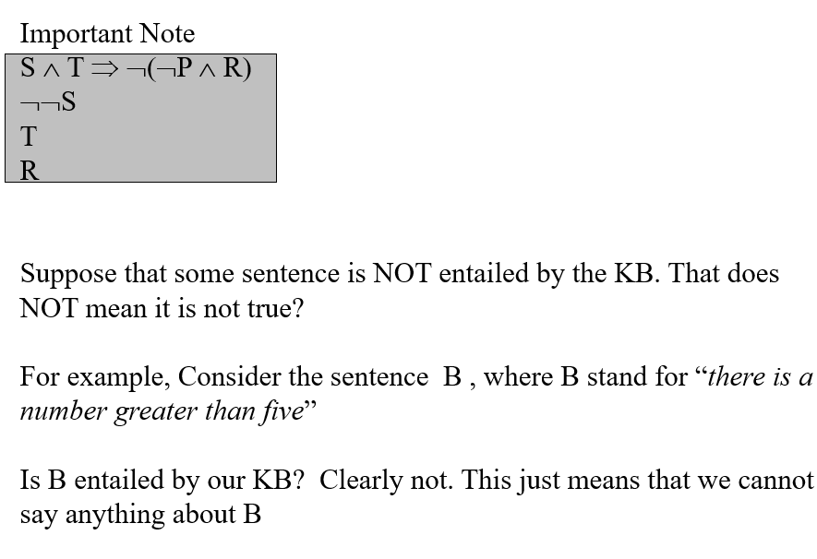

Slide 47
